Slide 1
Prediction of Daily Power Production of a Solar Panel.
Akshit Priyesh

Slide 2
Overview
This data has been gathered at a store. It is a combined set of data from a solar plate using sensor and other is hourly weather report of that time. There are a few areas of concern at the solar plate for making the store with enough power supply.
Can we predict the power generation for next couple of days? - this allows for better power management for that store.
Can we identify the need for panel cleaning/maintenance?
Can we identify faulty solar panel?

Slide 3
Main factors on which a solar panel depends on :
01
Time of day
02
The season of the year
03
The latitude of the area

Slide 4
Main factors on which a solar panel depends on :
04
clearness or cloudiness of the sky
05
Visibility (km)
03
Sudden/Conditional Events

Slide 5
Prediction of Daily Power Production of a Solar Panel.
Akshit Priyesh

Slide 6
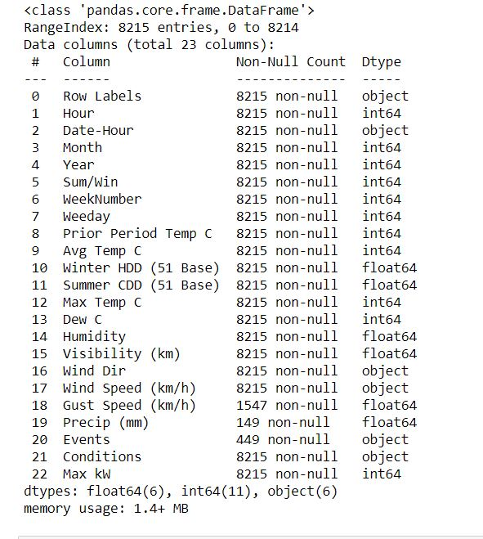
About the datasets used for prediction:

Slide 7
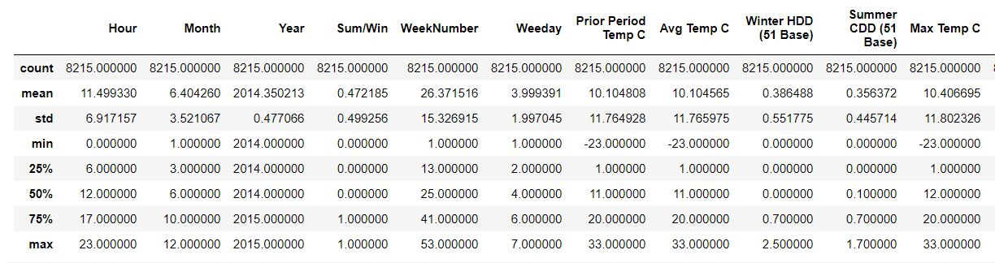
Descriptive Statistics of Data.

Slide 8
A bit more about the data sets
Missing Values : 22505
Missing Values in Columns: Humidity , Visibility, Wind Speed, Gust Speed, Precip, Events
75%
83%
42%
20%
Training Data Set
Data Used
Features Used
Test Data Set

Slide 9
Energy Production trends
100%
100%
80%
80%
60%
60%
40%
40%
20%
20%
0%
0%
Q2
Q3
Q4
Q1
Q2
Q3
Q4
2014
2015

Slide 10
Steps Involved In Prediction
04
Exploratory Data Analysis
Deployment
01
03
Visualization, Training & Testing
Optimization
02

Slide 11


About the code.
https://github.com/akshitpriyesh

Slide 12
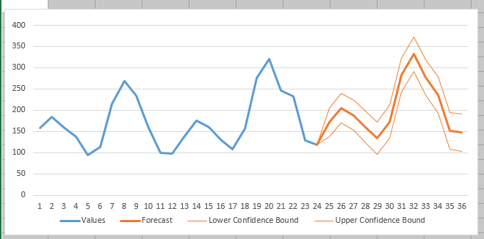

Slide 13
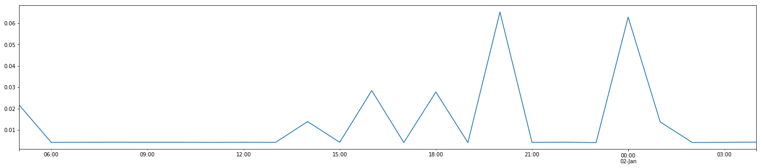
Analysis of One Specific Day

Slide 14
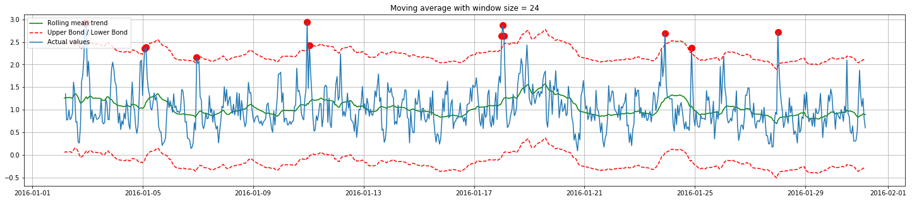
Anomaly Detection

Slide 15
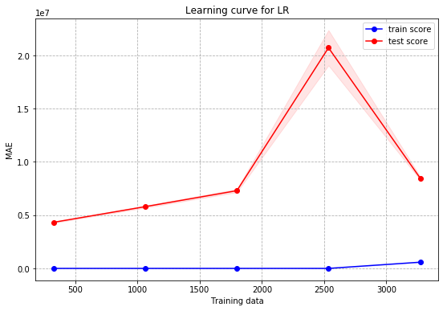
Learning Curve

Slide 16
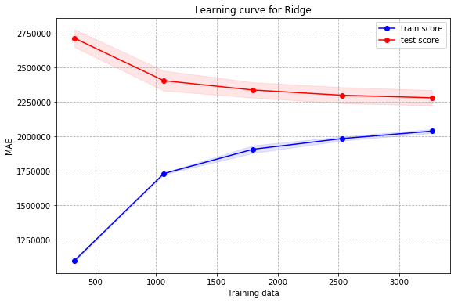
Train test result

Slide 17
Accuracy % = 63

Slide 18
FUTURE
We can automate the process of feeding the data from any weather forecast api and see the prediction on any device in any part of this world. Also we can select more features in order to increase our accuracy. The model used was a baseline model as a part of the case study.

Slide 19
Thank you!
Akshit Priyesh!

